Slide 1
Cloud Forensics
Team: Josh Mpere, Sam Mendimasa, Nikola Slavov
Sponsor: Al Holt with National Security Agency
Advisor: Dr. Haibin Zhang

Slide 2
Agenda
Problem Statement
Project Overview & Plan
Cloud Computing
Memory Forensics
Results and Findings
Future Work

Slide 3
Introduction / Problem Statement
Problem: When a cloud instance is terminated all the data that was stored locally on that instance is deleted. So in the case of a compromise no evidence is preserved.
Goal: To provide a way to perform digital forensics on instances in the cloud.

Slide 4
Project Description
Design a framework that collects memory and data from VMs before the instance gets terminated
Conduct forensics analysis and determine what malicious activities occurred.
Develop metrics of amount of information that is collected from a cloud environment with different forensic tools

Slide 5
Tools & Background
Devstack Rocky and Stein
Virtualbox
Kali linux
Volatility
Dumpit

Slide 6
Our Ideal Setup
In practice we would have 3 virtual machines setup.
End user
Attacker
Forensic analyst
The end user on a
The forensic analyst will be on a separate network offline.

Slide 7
Cloud Computing
Delivery of computing services, ex. virtualization, servers, storage, databases, software, and more.
IaaS (Infrastructure as a Service), SaaS(Software as a Service), PaaS(Platform as a Service)
Examples: Amazon AWS, OpenStack, Google Cloud Platform
Benefits:
Flexibility, Full control, Scalability, and Security

Slide 8
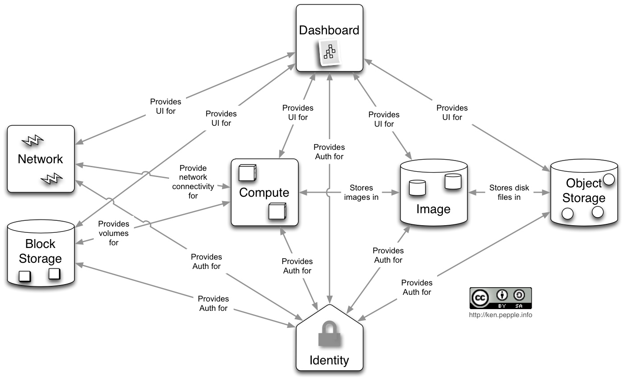
Devstack Framework
Open source platform for cloud computing
Used by over 500+ companies as basis for their private cloud
Devstack is single server variant of Openstack

Slide 9
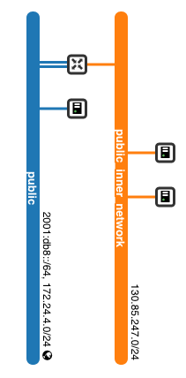
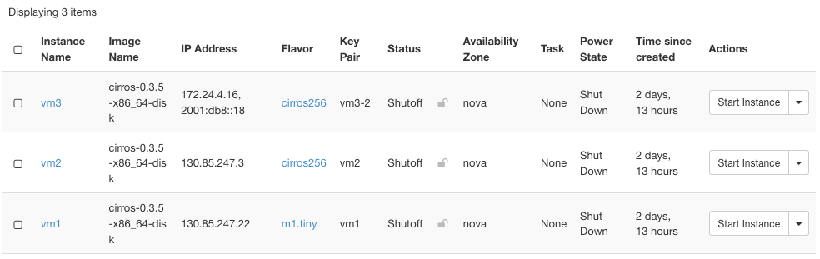
Cloud Framework
Resources: 100+ gb storage, 6 gb RAM

Slide 10
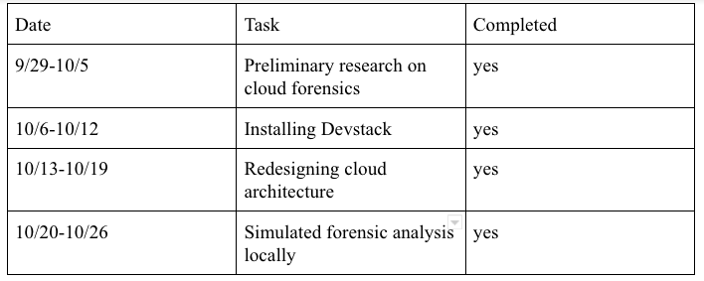
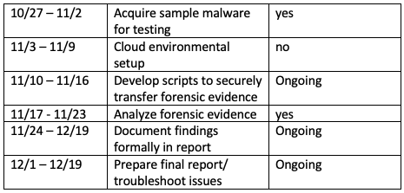
What we did?

Slide 11
Cloud Framework Concerns
Failed instance loading
No connection to the outside Internet (UMBC Network blocks ICMP and connections to outside networks)
Attempted workarounds:
Load malicious image to attack other instances
Load a compromised image from a snapshot
Solution: use VirtualBox to simulate a cloud

Slide 12
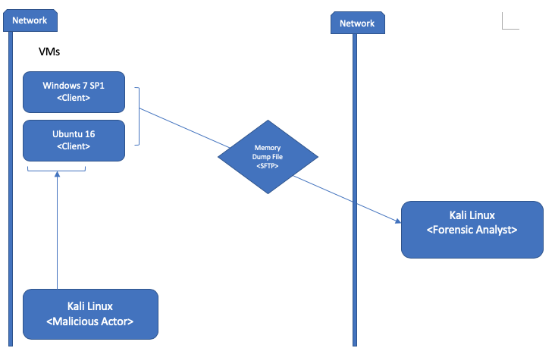
Virtual Box Design

Slide 13
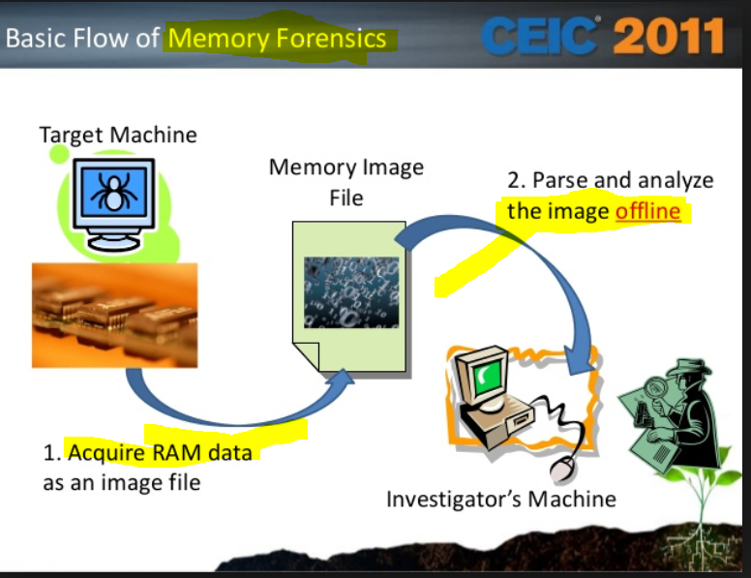
What is Memory Forensics?
•Memory forensics refers to the analysis of the volatile data of a computer contained it its memory dump.
•This occurs when one acquires the ram from a machine and is able to analyze that file offline.

Slide 14

Why Forensics is important
Processes must be loaded into memory(“you can run but you can’t hide”)
The memory can provide insights into system activity at runtime.
Some data related to the attack exists solely in memory

Slide 15
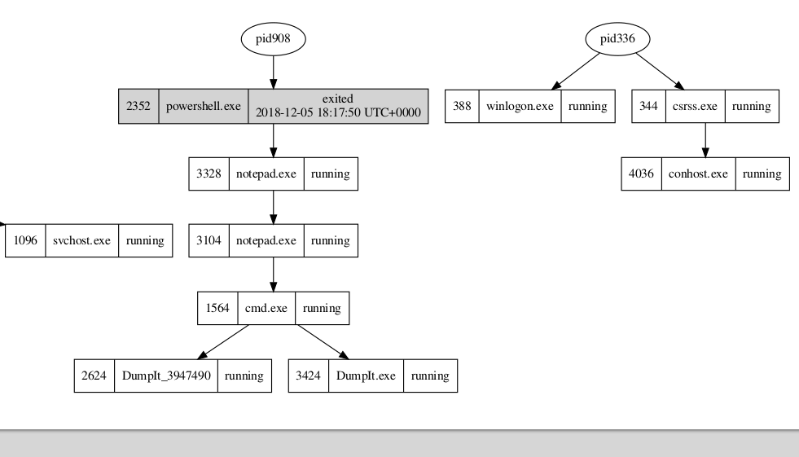
Results / Findings
This graph shows the parent-child relationship of the processes spawned by the malicious actor.

Slide 16
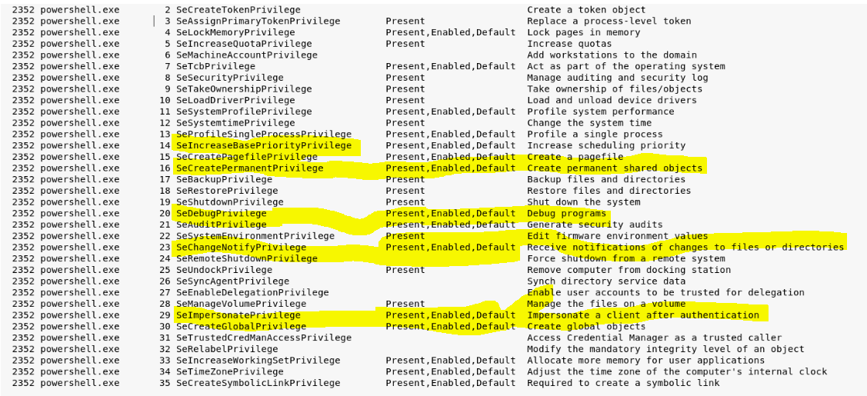
Results / Findings
Here we used the privs plugin to determine privileges gained by the attacker.

Slide 17
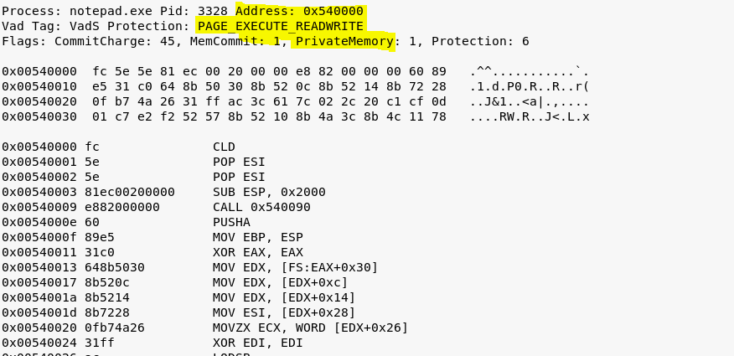
Findings
Using the malfind plugin we found code injected into other processes.

Slide 18
Conclusion and Future Work
Memory dumps proved to be an effective way to detect malware in cloud environments.
Look into other forensics tools to analyze cloud related cyber crime
Design another Framework to address problems faced by forensic investigators in cloud computing.
Further looking into configuring Devstack

Slide 19
Questions?

